Slide 1


Slide 2
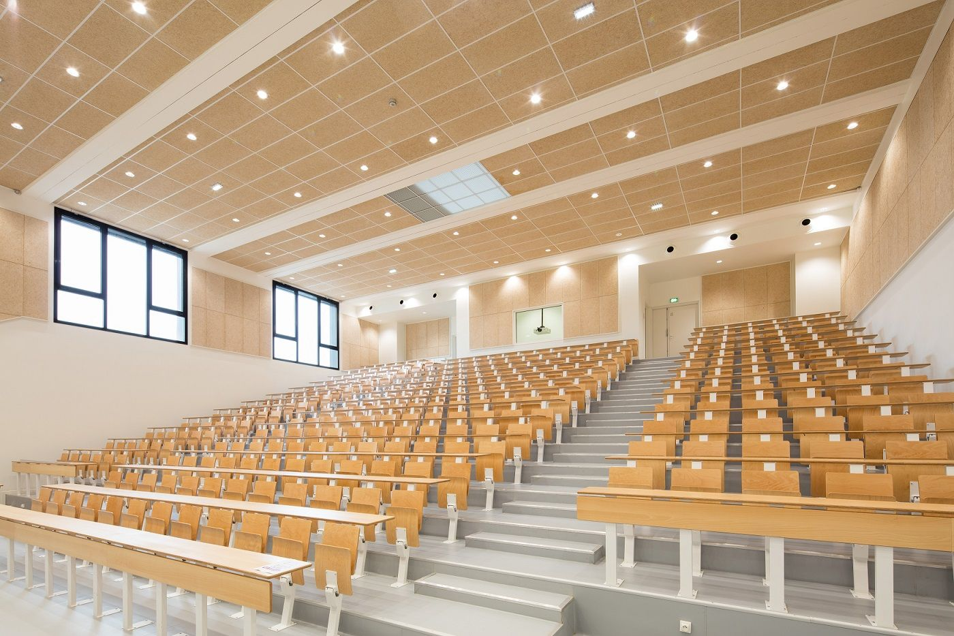
Smart Classroom
- Team members:
1- Mostafa Usama
2- Mohamed Ramadan
3- Mohamed Nabil 4- Nourhan Mahmoud
5- Sondos Osama
6- Manar Mohamed
- Supervised by:
Dr. Abdelrahaman Hedar

Slide 3
Agenda
3
Problem and Solution
Quick
Overview
New Model
Interface
Demo
Future Work

Slide 4

Problem VS. Solution

Slide 5
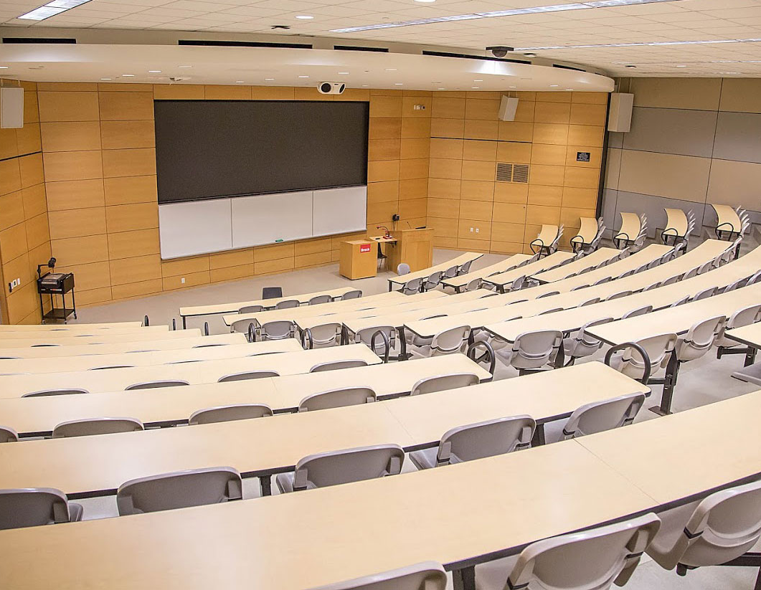
Too much wasted Energy !!

Slide 6

So, What can we do?

Slide 7

Quick Overview

Slide 8
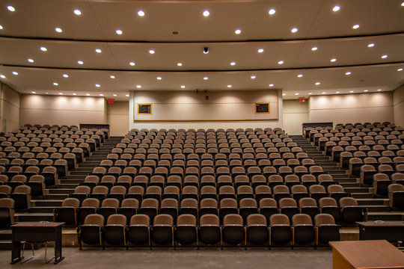
Sections
8

Slide 9





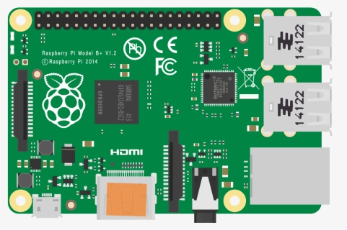




Architecture
Tools

Slide 10

What’s New?

Slide 11

New Model

Slide 12


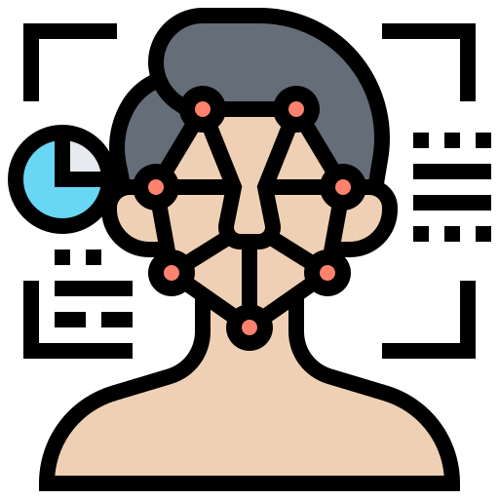
Build and deploy your models faster and easier!

Slide 13
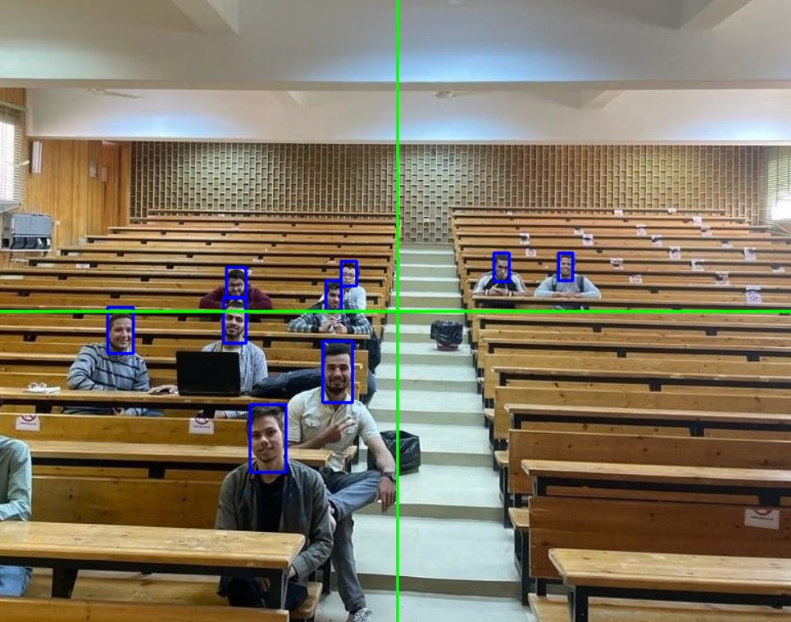
Better Accuracy!!

Slide 14

Interface

Slide 15

Users
Manually or Automatically?

Slide 16
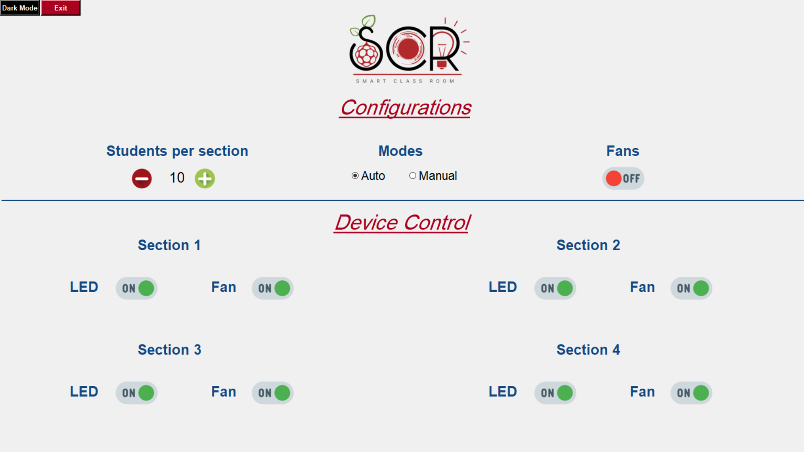

Slide 17
Admin
Manage Everything!!

Slide 18
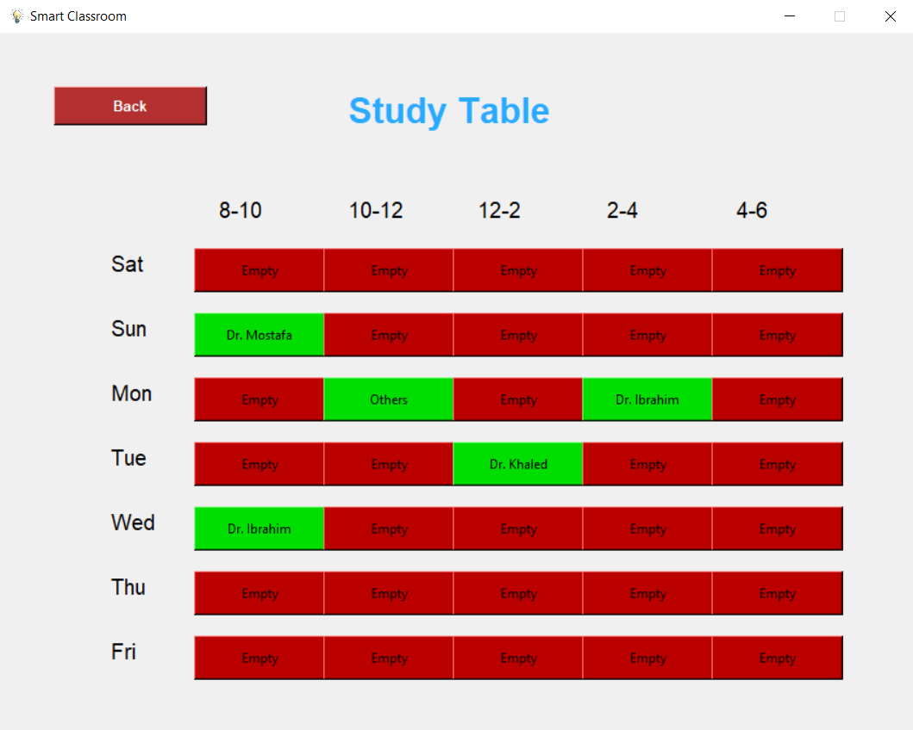

Slide 19

Future Work

Slide 20
Future Work
20
Better Accuracy
Voice Control
Website

Slide 21

THANK YOU

